Slide 20
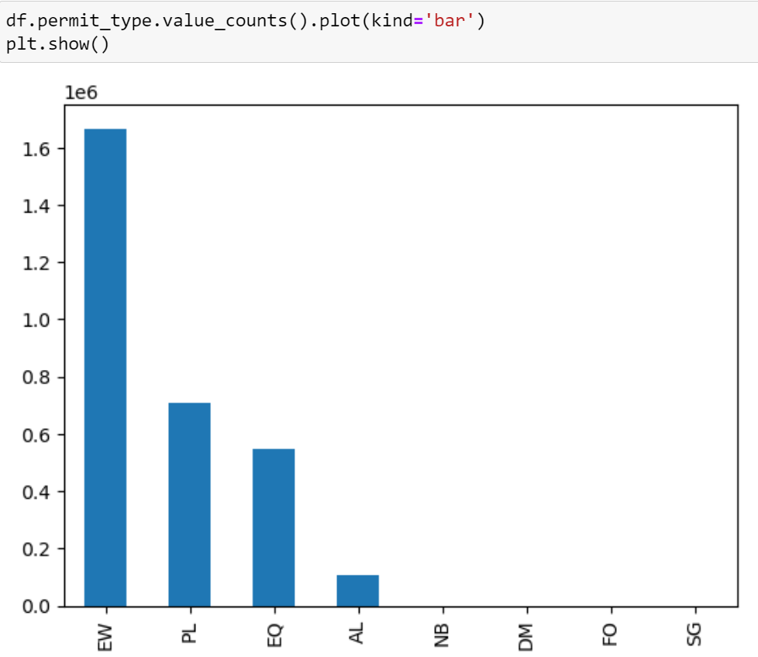
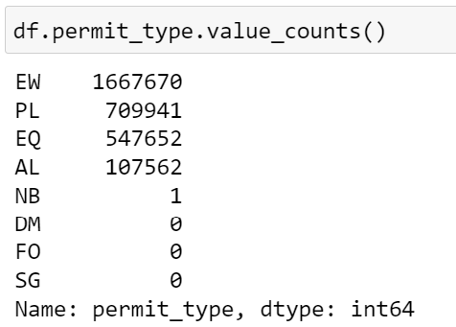
Milestone 2
There is a lot of bias among the label values. One method we thought of was over-sampling, but it was impractical since we would have over-sample the low frequency data by a factor of 10 and also there are a lot of categories with no records.

Slide 21
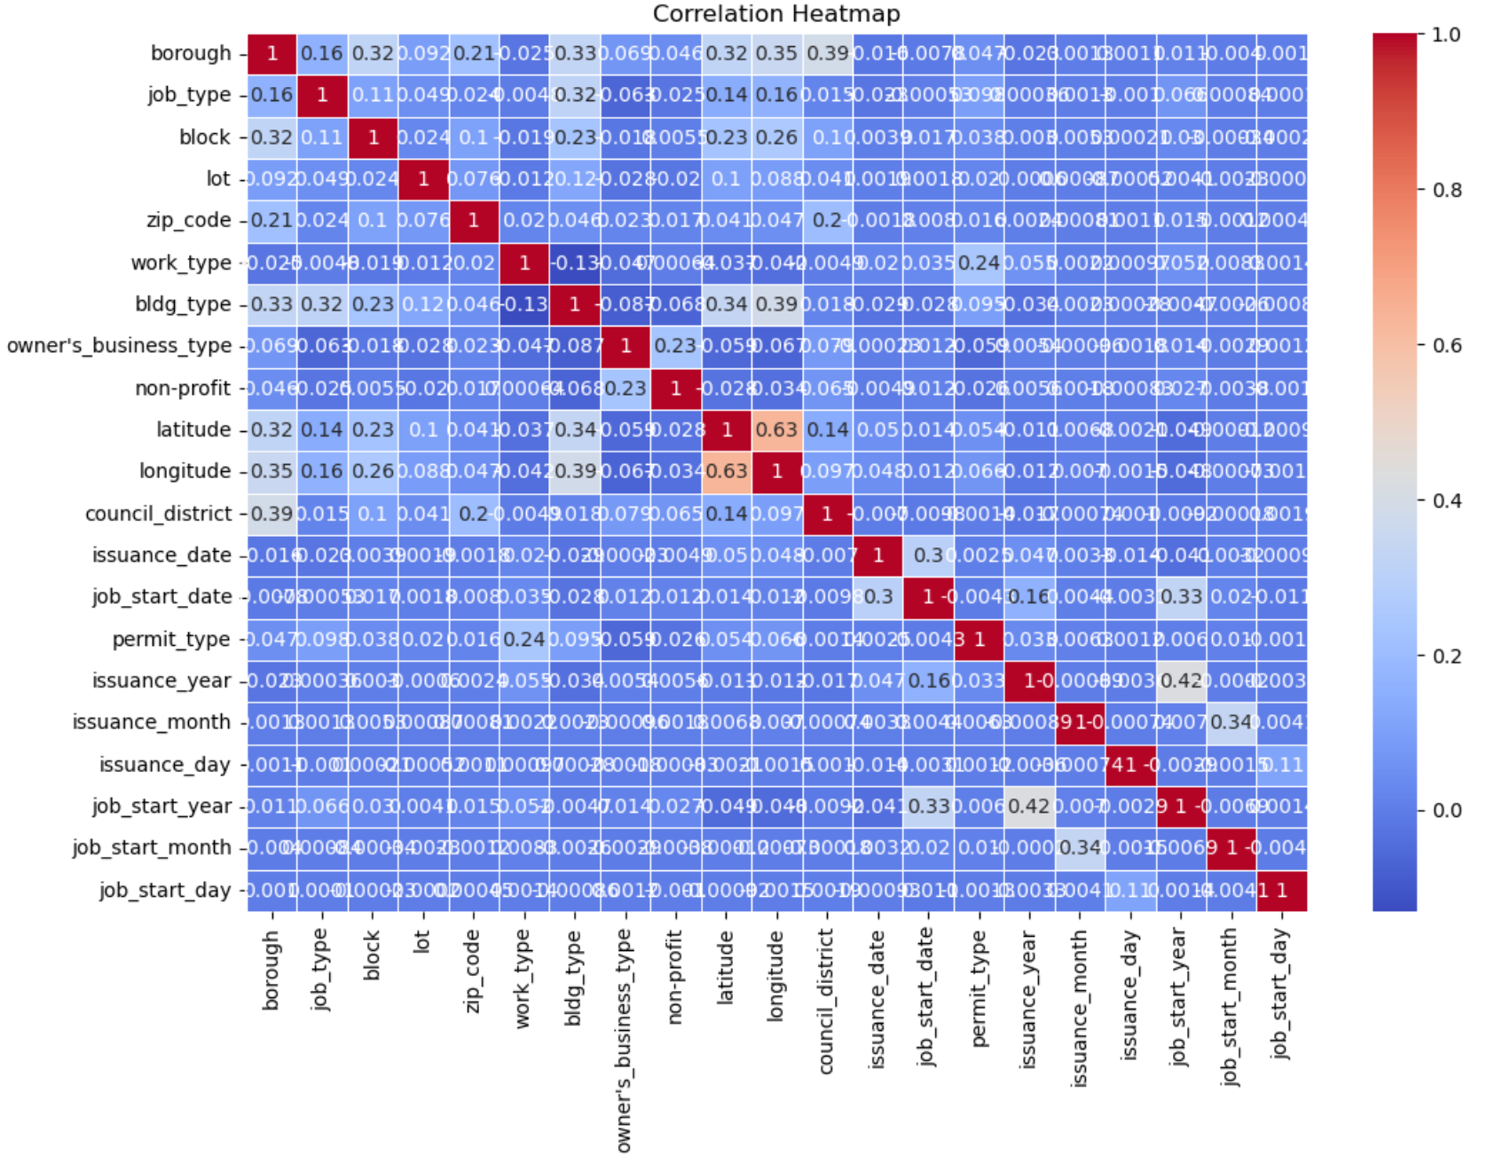
Milestone 2
We see that there is minimal correlation among the feature variables which is a desirable characteristic for our baseline model.

Slide 22
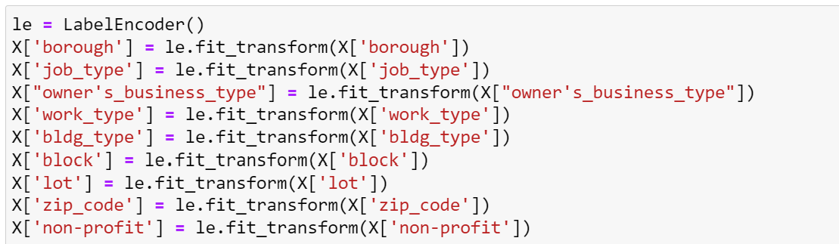
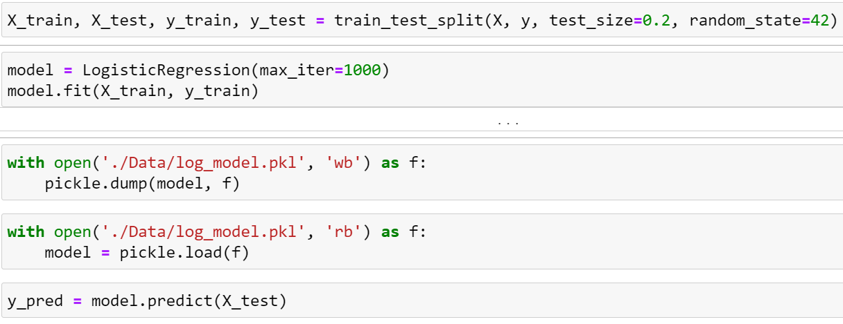
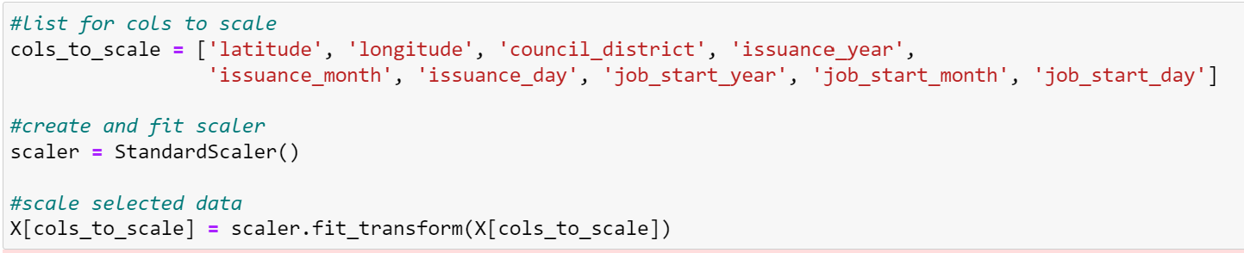
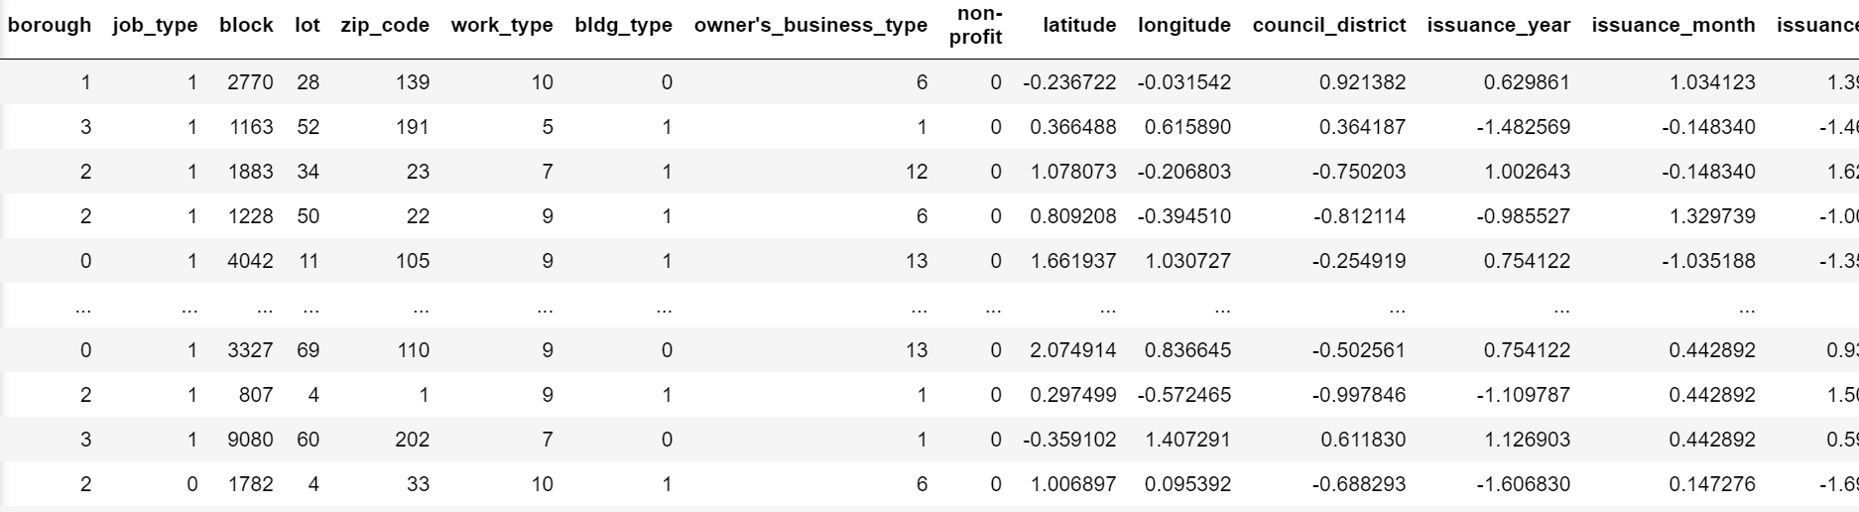
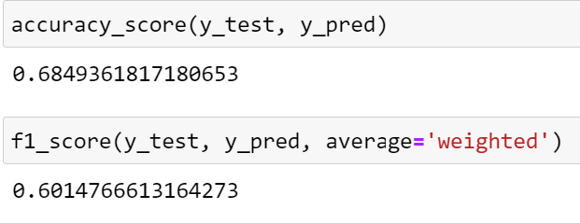
Milestone 2
Baseline Model – Logistic Regression

Slide 23
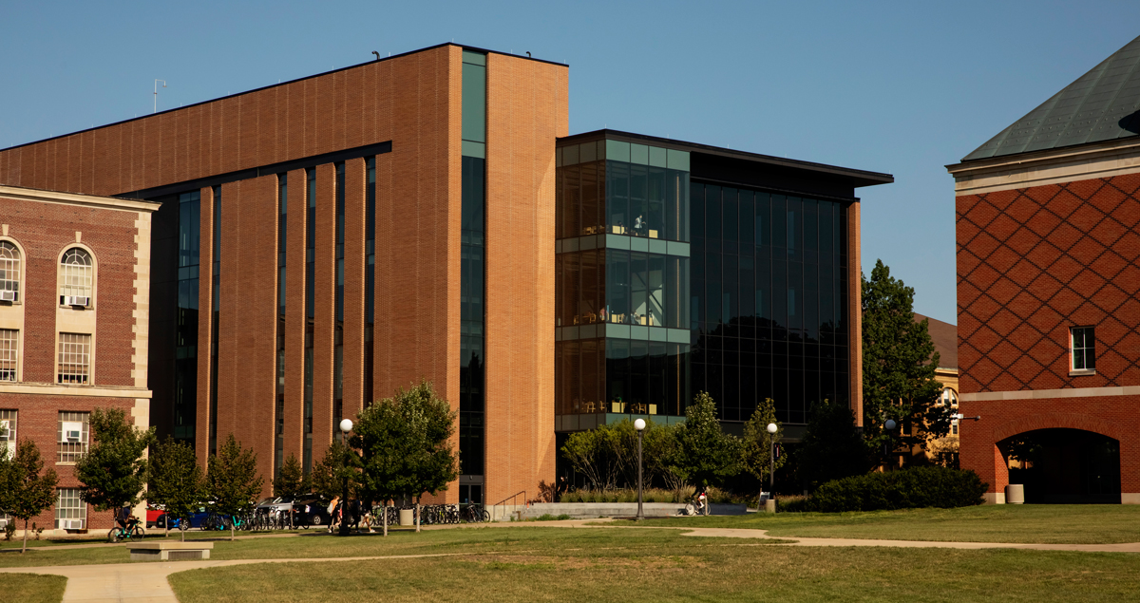

*NOTE*
(please delete)
Use a photo cropped to size for the entire slide like the example slide. Send the photo to the back so the blue box, Block I and footer text are not covered.

Slide 24

*NOTE*
(please delete)
Use a photo for the entire slide like this example slide. Send the photo to the back so the blue box, gradient box, Block I and footer text are not covered.

Slide 25

*NOTE*
(please delete)
Use a photo for the entire slide like this example slide. Send the photo to the back so the blue box, gradient box, Block I and footer text are not covered.

Slide 26
*NOTE*
(please delete)
Please insert charts through PowerPoint to ensure they follow University Brand standard colors. If using a personal chart, please ensure chart colors match with Brand standards.

Slide 29


Slide 30


